Slide 1

Setting up your ML application
Train/dev/test
sets
deeplearning.ai

Slide 2

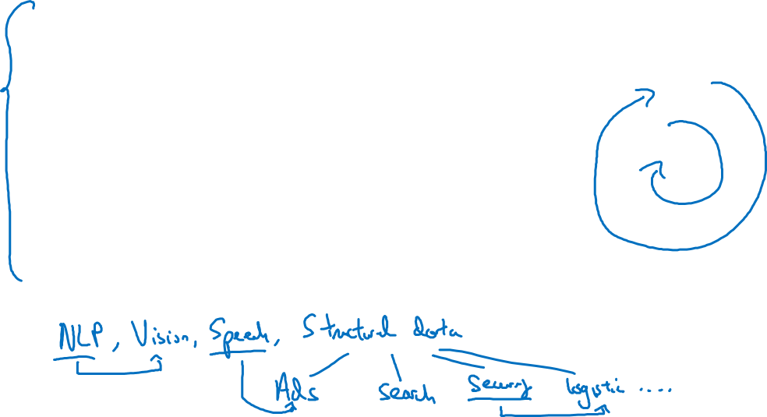
Applied ML is a highly iterative process
# layers
Idea
# hidden units
learning rates
activation functions
…
Experiment
Code

Slide 3
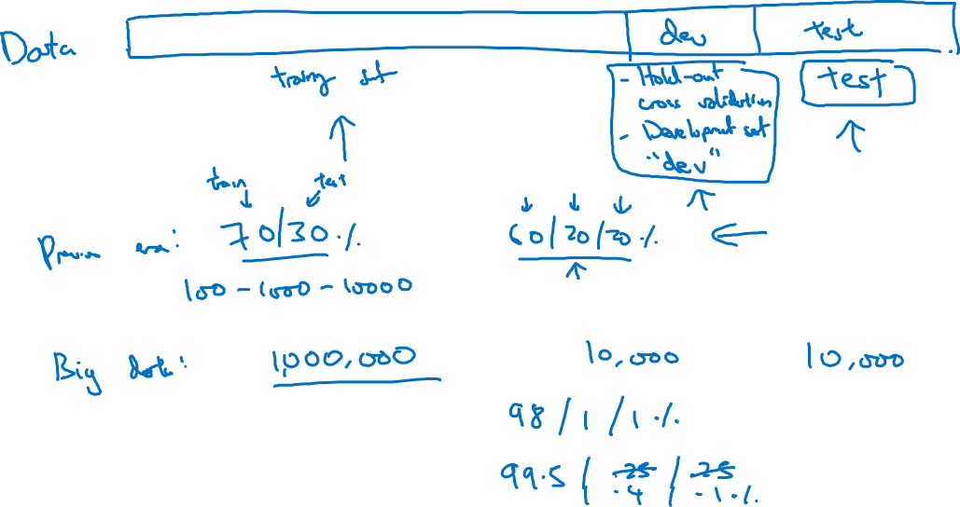
Train/dev/test sets

Slide 4
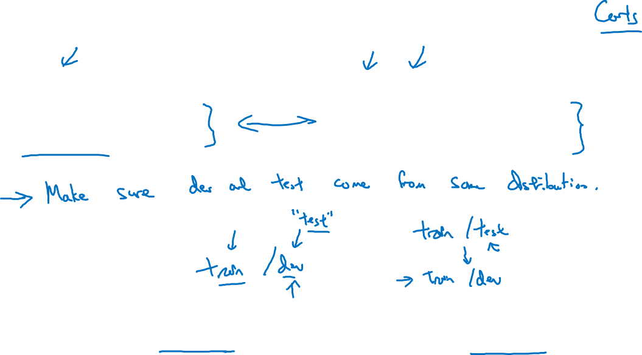
Mismatched train/test distribution
Training set:
Cat pictures from webpages
Dev/test sets:
Cat pictures from users using your app
Not having a test set might be okay. (Only dev set.)

Slide 5
Setting up your ML application
Bias/Variance
deeplearning.ai

Slide 6
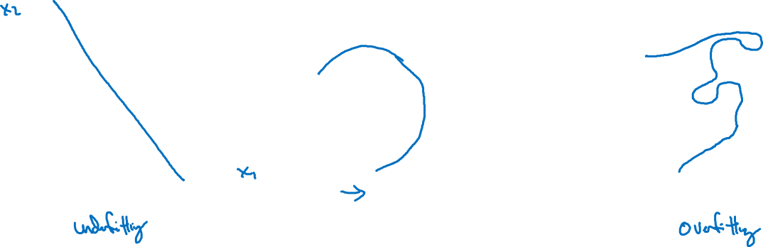
Bias and Variance
high bias
“just right”
high variance

Slide 7
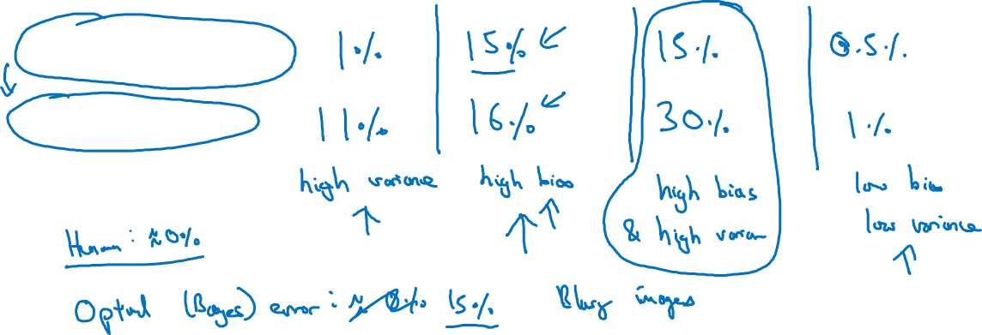

Bias and Variance
Cat classification
Train set error:
Dev set error:

Slide 8
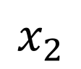
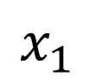
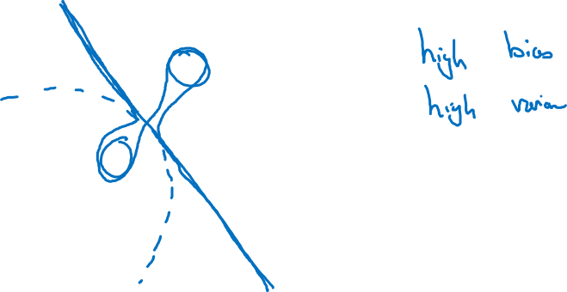
High bias and high variance
$$x_{2}$$
$$x_{1}$$

Slide 9
Setting up your ML application
Basic “recipe”
for machine learning
deeplearning.ai

Slide 10
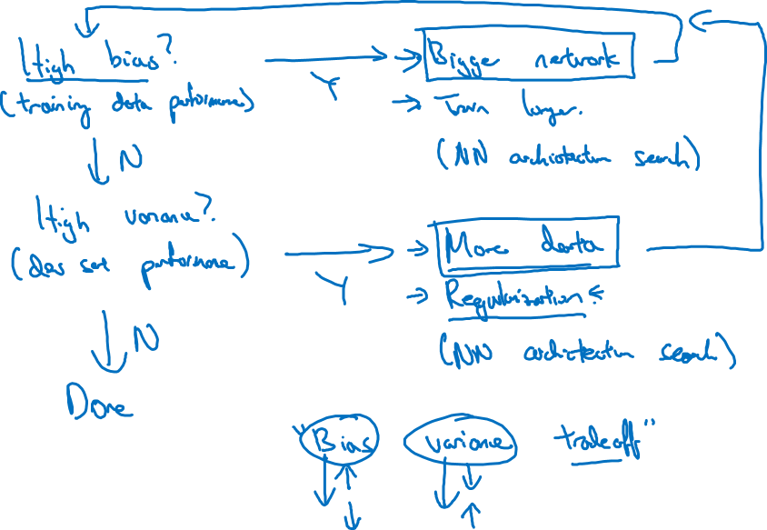
Basic recipe for machine learning

Slide 11
Regularizing your neural network
Regularization
deeplearning.ai

Slide 12
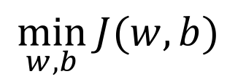
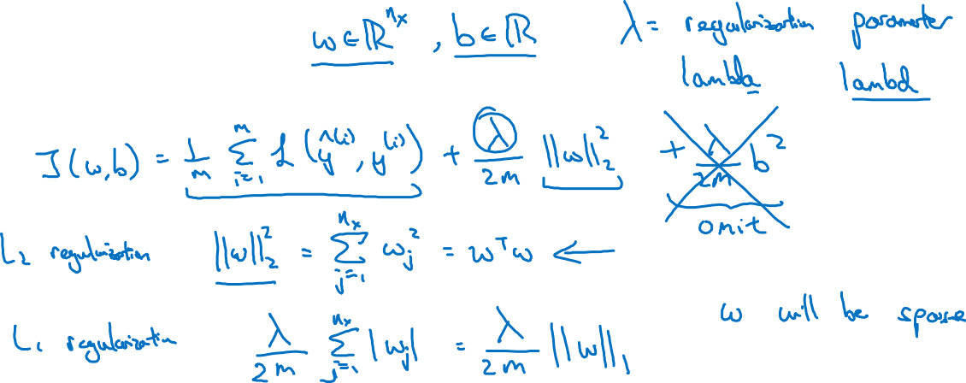
Logistic regression
$$\min_{w,b}{J(w,b)}$$

Slide 13
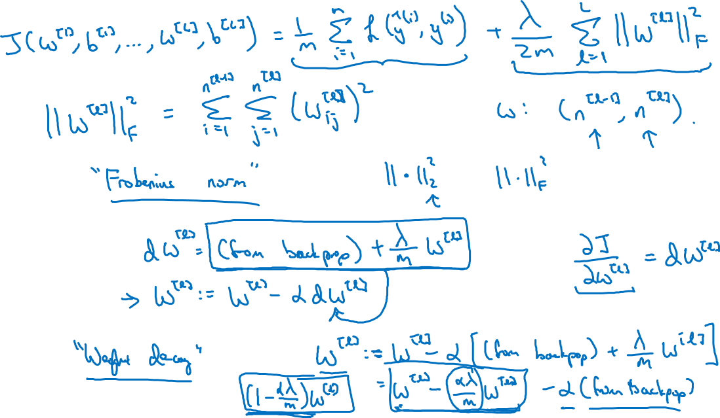
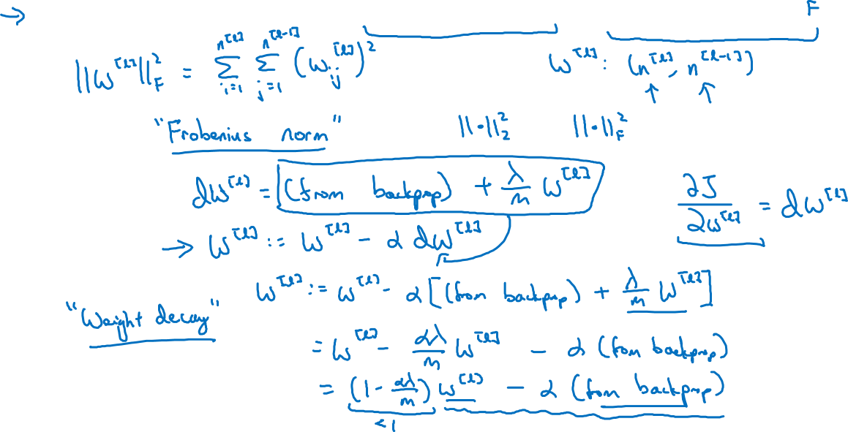
Neural network

Slide 14
Neural network

Slide 15
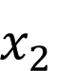
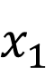
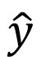
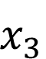
How does regularization prevent overfitting?
$$x_{1}$$
$$x_{2}$$
$$\hat{y}$$
$$x_{3}$$

Slide 16
Regularizing your neural network
Why regularization reduces overfitting
deeplearning.ai

Slide 17
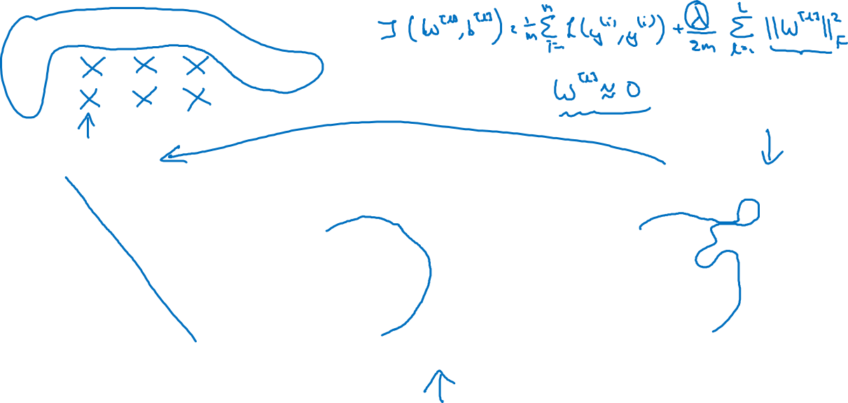
How does regularization prevent overfitting?
$$x_{1}$$
$$x_{2}$$
$$\hat{y}$$
$$x_{3}$$
high bias
“just right”
high variance

Slide 18
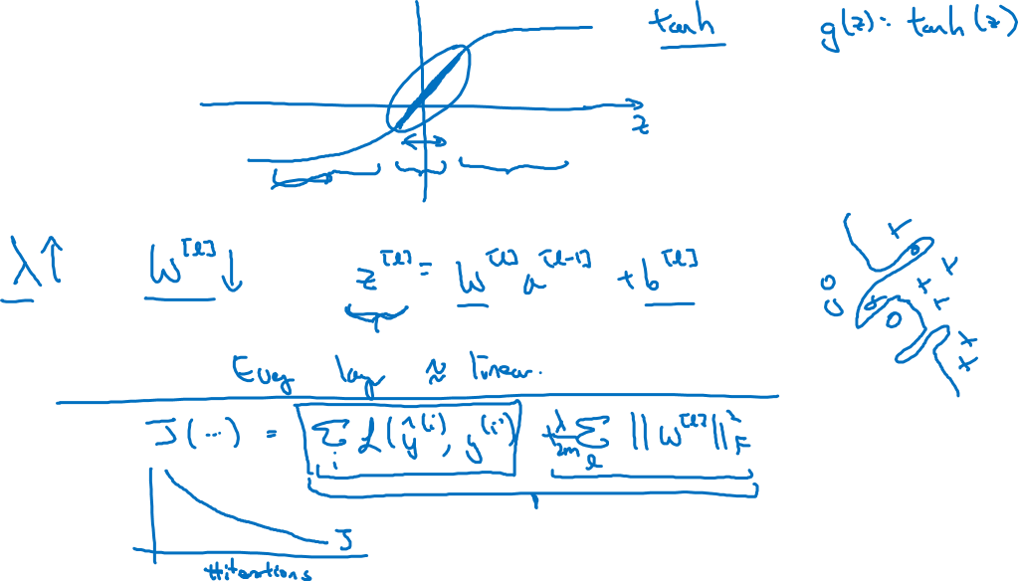
How does regularization prevent overfitting?

Slide 19
Regularizing your neural network
Dropout
regularization
deeplearning.ai

Slide 20
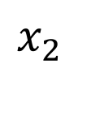
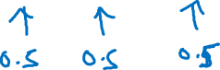
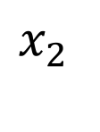
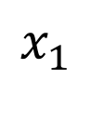
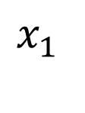
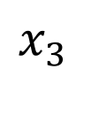
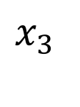
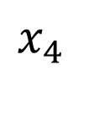
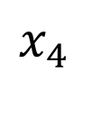
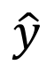
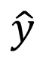
Dropout regularization
$$x_{1}$$
$$x_{1}$$
$$x_{2}$$
$$x_{2}$$
$$\hat{y}$$
$$\hat{y}$$
$$x_{3}$$
$$x_{3}$$
$$x_{4}$$
$$x_{4}$$

Slide 21
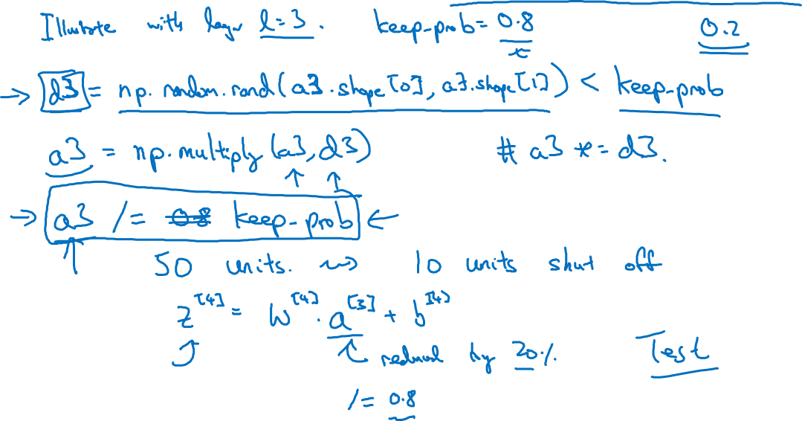
Implementing dropout (“Inverted dropout”)

Slide 22
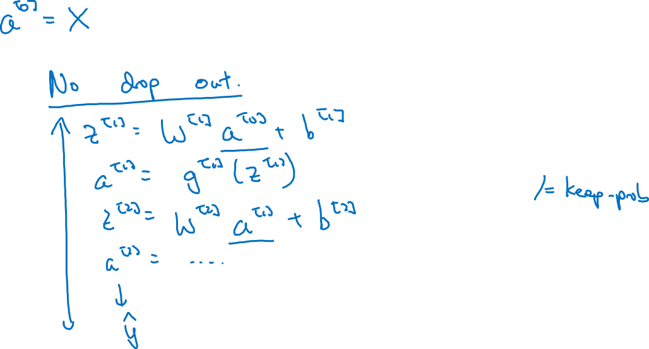
Making predictions at test time

Slide 23
Regularizing your neural network
Understanding
dropout
deeplearning.ai

Slide 24
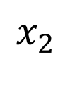
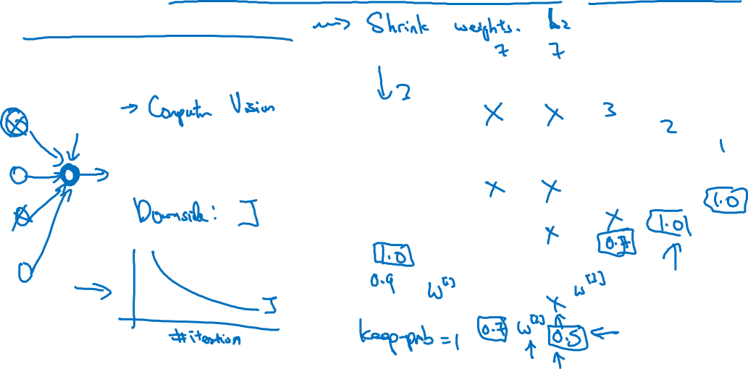
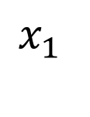
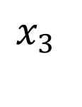
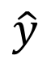
Why does drop-out work?
Intuition: Can’t rely on any one feature, so have to
spread out weights.
$$x_{1}$$
$$x_{2}$$
$$\hat{y}$$
$$x_{3}$$

Slide 25
Regularizing your neural network
Other regularization
methods
deeplearning.ai

Slide 26




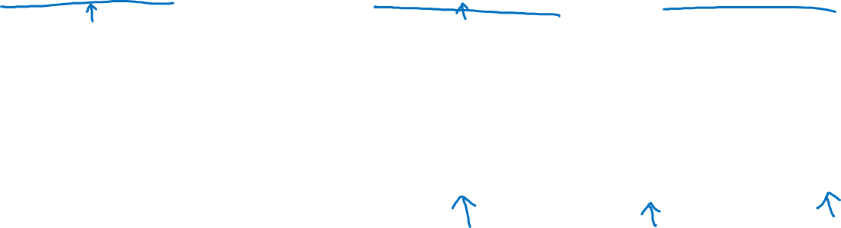
Data augmentation
4

Slide 27
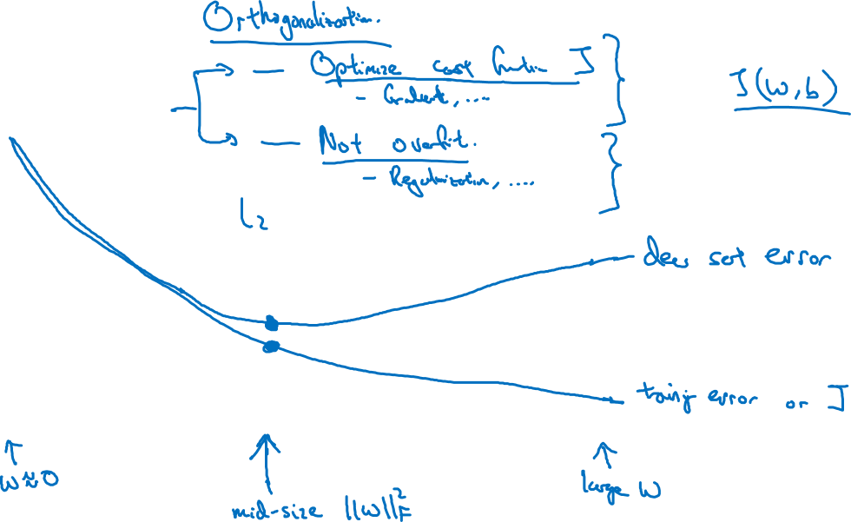
Early stopping
# iterations

Slide 28
Setting up your optimization problem
Normalizing inputs
deeplearning.ai

Slide 29
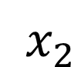
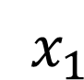
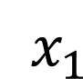
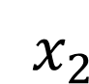
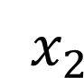
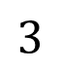
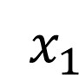
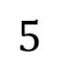
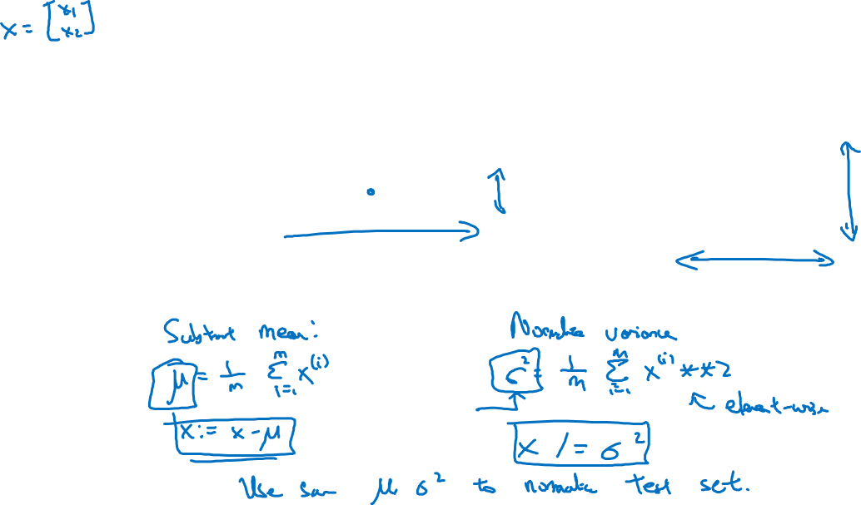
Normalizing training sets
$x_{2}$
$x_{2}$
$$3$$
$x_{2}$
$x_{1}$
$x_{1}$
$x_{1}$
$$5$$

Slide 30
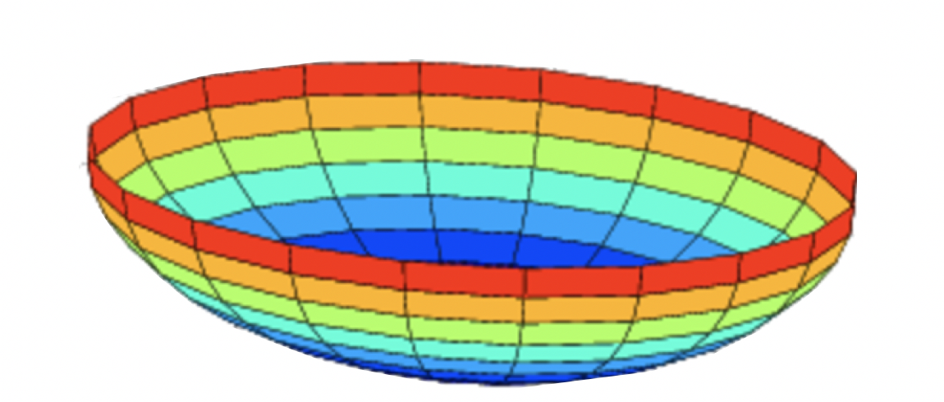

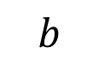













Why normalize inputs?
$$J\left(w,b\right)=\frac{1}{m}$$
$$\sum_{i=1}^{m}{ }$$
$$ℒ ({\hat{y}}^{\left(i\right)},y^{(i)})$$
Unnormalized:
Normalized:
$$J$$
$$J$$
$$w$$
$$w$$
$$b$$
$$b$$
$$b$$
$$b$$
$$w$$
$$w$$

Slide 31
Setting up your optimization problem
Vanishing/exploding
gradients
deeplearning.ai

Slide 32




Vanishing/exploding gradients
$x_{1}$
$$\hat{y}$$
$x_{2}$
=

Slide 33







Single neuron example
$x_{1}$
$x_{2}$
$$\hat{y}$$
$x_{3}$
$x_{4}$
$$a=g(z)$$

Slide 34
Note: the font is smaller than usual here so it fits nicely.
Setting up your optimization problem
Numerical approximation
of gradients
deeplearning.ai

Slide 35


Checking your derivative computation
$$f$$

Slide 36


Checking your derivative computation
$$f$$

Slide 37
Setting up your optimization problem
Gradient Checking
deeplearning.ai

Slide 38

Gradient check for a neural network
Take $W^{\left[1\right]},b^{[1]},…,W^{\left[L\right]},b^{\left[L\right]}$ and reshape into a big vector $θ.$
Take ${dW}^{\left[1\right]},{db}^{[1]},…,{dW}^{\left[L\right]},{db}^{\left[L\right]}$ and reshape into a big vector $dθ.$

Slide 39

Gradient checking (Grad check)

Slide 40
Setting up your optimization problem
Gradient Checking
implementation notes
deeplearning.ai

Slide 41


Gradient checking implementation notes
- Don’t use in training – only to debug
- If algorithm fails grad check, look at components to try to identify bug.
- Remember regularization.
- Doesn’t work with dropout.
- Run at random initialization; perhaps again after some training.

